Slide 1
Sehun Babatunde

Slide 2
Introduction
I’m Sehun :)
Joined QA – December 2020
Always had a interest in technology (video games FTW!) Graduated from a software engineering degree in July 2020

Slide 3
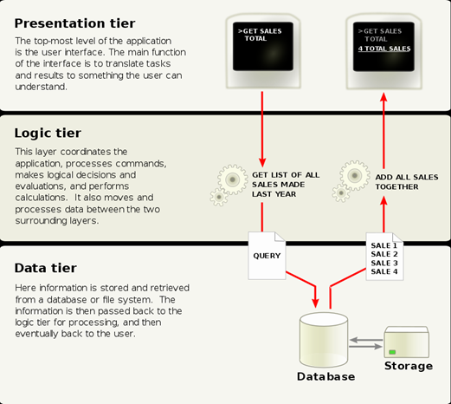
Approach - Previous CRUD Applications
Three Tired Model
Three- Tiered Architecture model

Slide 4
Consultant Journey
Git (Three feature branch model) & Github
Java Programming Language
OOP Concepts
Project Management (Jira, user stories, acceptance criteria)
Unit Testing (JUnit)
Maven
MySQL (SQL,Workbench)

Slide 5
CI – Version Control
The o’l reliable:Three feature branch Model
Benefits: Continues Integration & Development

Slide 6
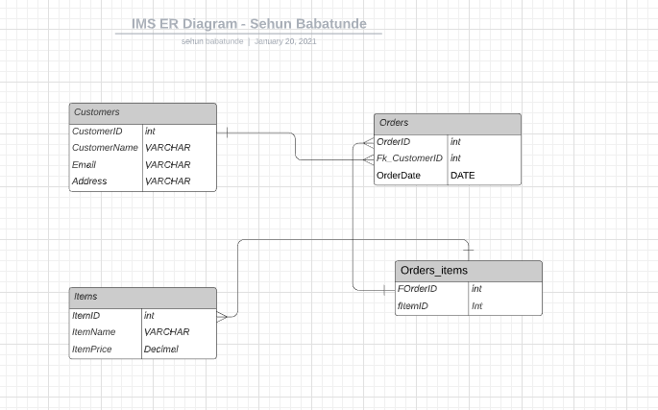
ER Diagram

Slide 7
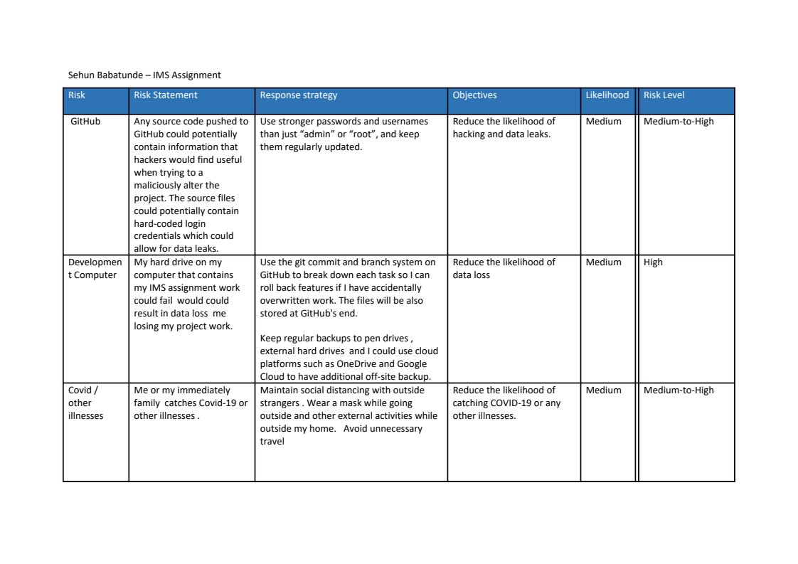

Slide 9
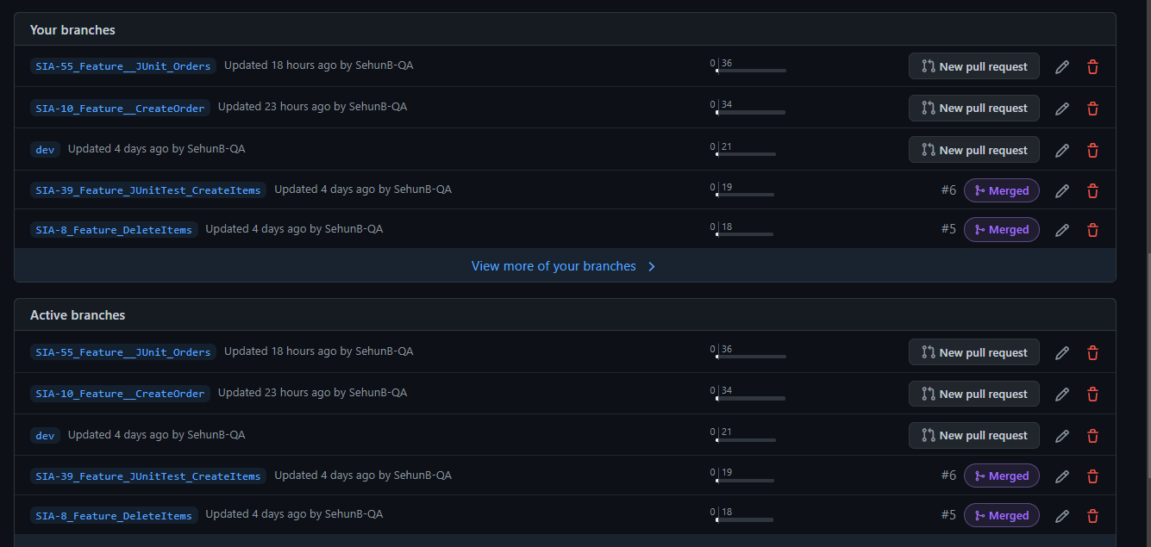

Slide 10
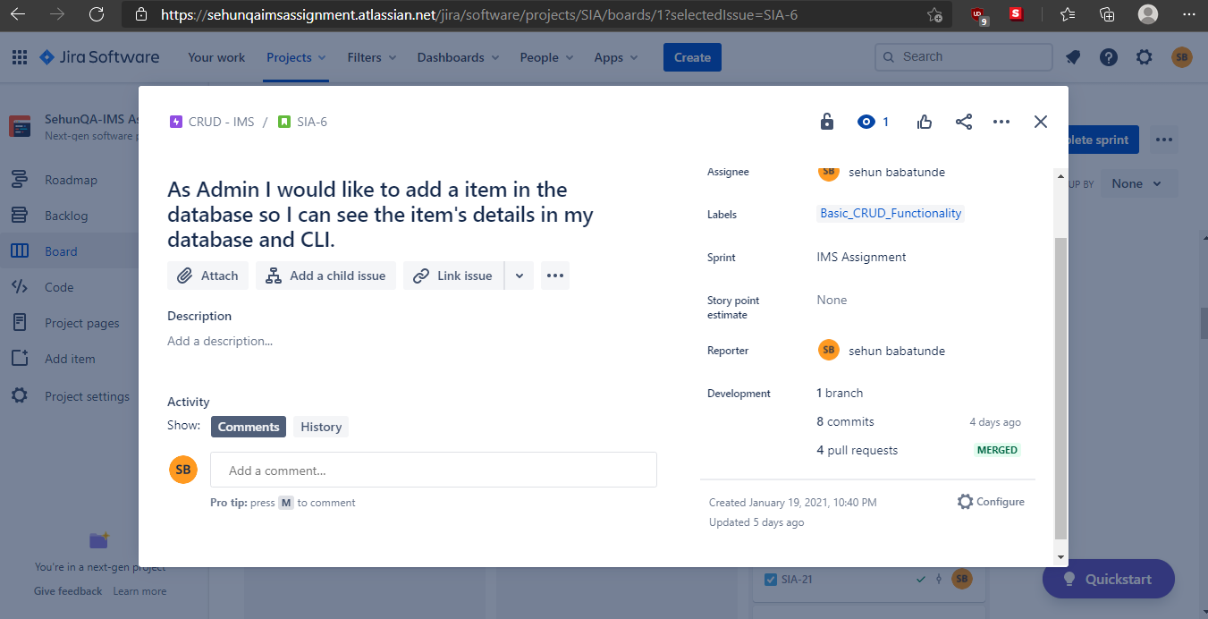

Slide 11
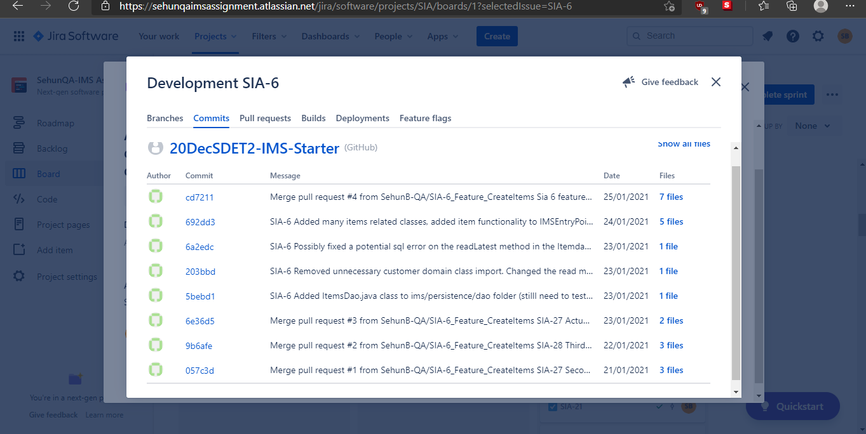

Slide 12
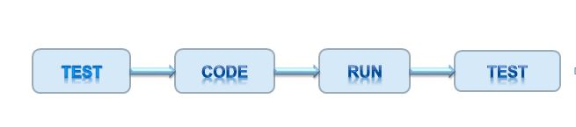
Testing
Why use JUnit & what's the purpose of Unit Testing? –
To confirm that our program and it’s behaviour works as intended!

Slide 13
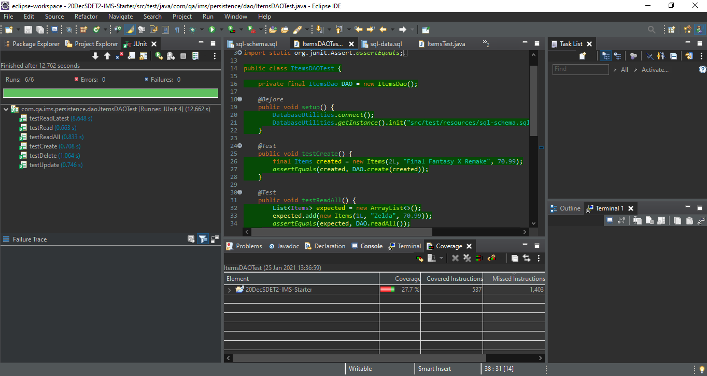
Testing

Slide 14
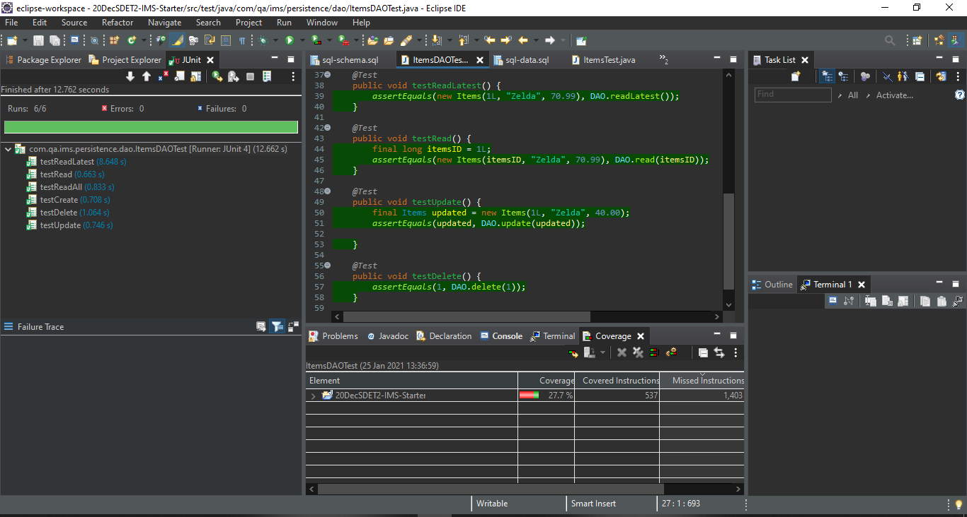

Slide 15
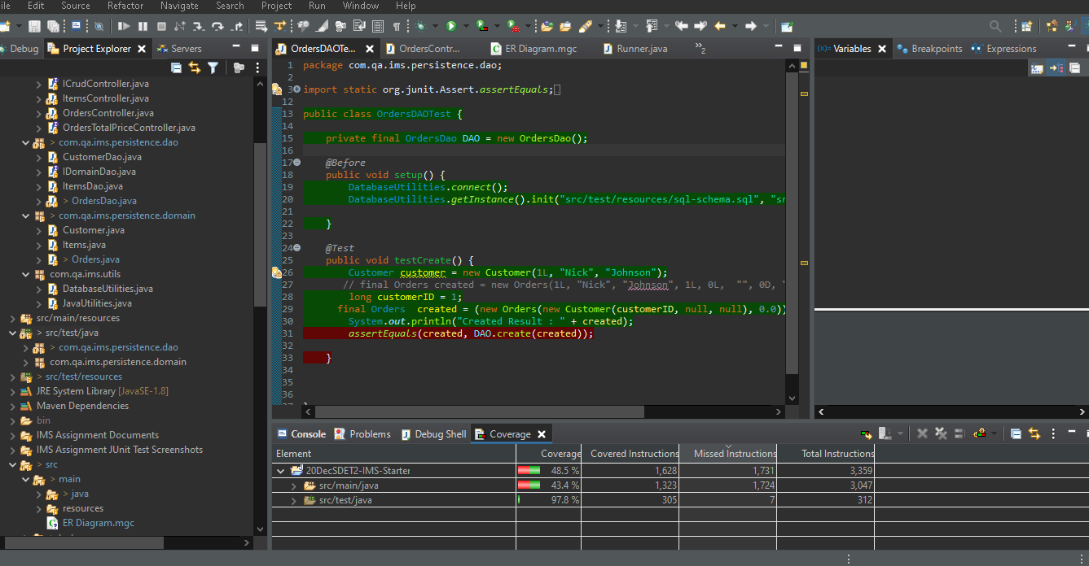
:(

Slide 16
Junit helped me catch a bug in my program!
Example- I got a constraint sql error in my customer delete test when deleting a customer that has a related order attached to it.

Slide 17
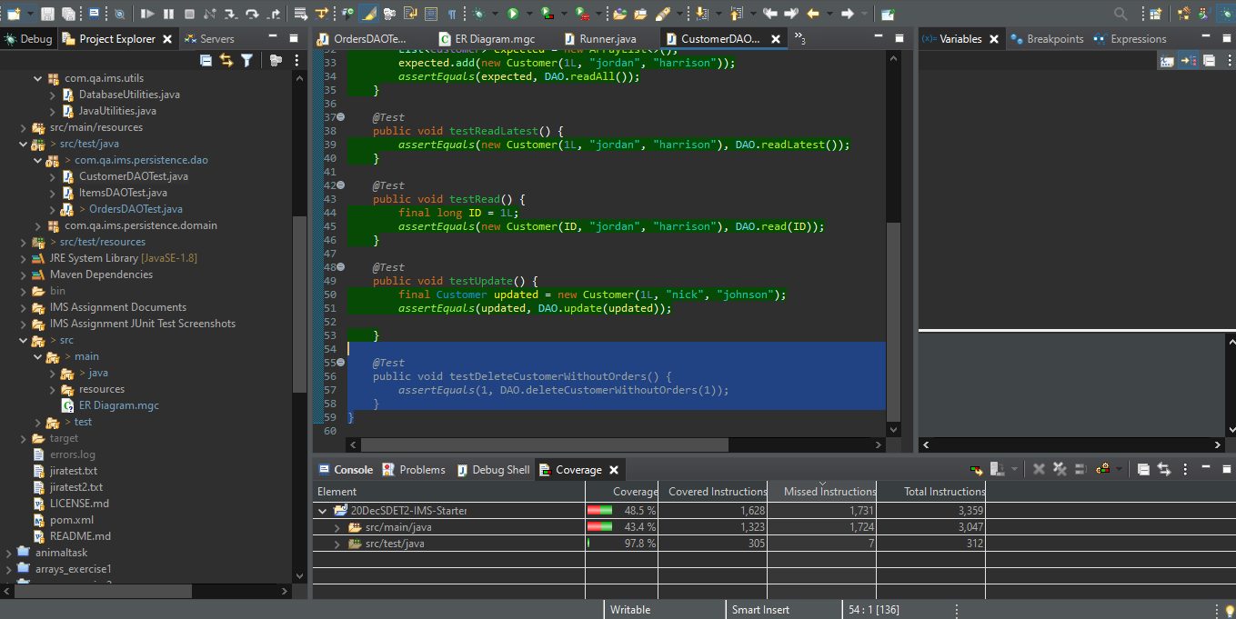

Slide 18
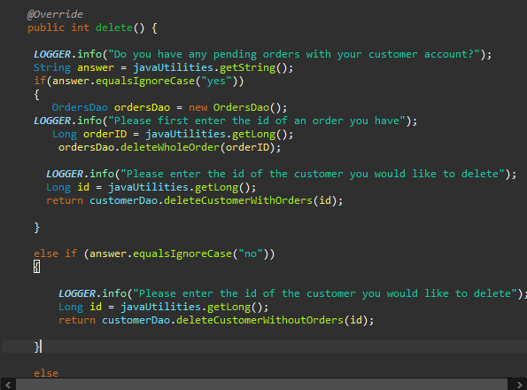

Slide 19
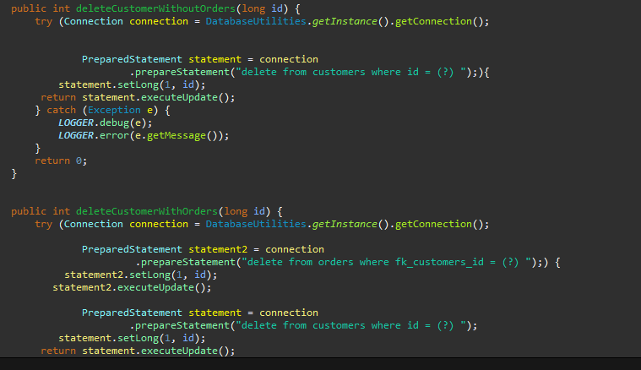

Slide 20
The Fun Part: The demo!

Slide 21
Sprint Review
Jira Board - https://sehunqaimsassignment.atlassian.net/jira/software/projects/SIA/boards/1
Complete: Full User stories, Added a multiple item to order function, refactored sql staements that deal with user input to prepared statements.
Left of: Junit testing of OrderDAO,

Slide 22
Sprint Retrospective
Overall : Went well and helpful
Things to improve:More breakdown of tasks
Full Junit tests of the OrdersDAO

Slide 23
Conclusion
Successes :
I have learned a lot
Proud of project
Good Challenge
Met great people
Improvements and moving ahead:
-Dont overstress
- Have regular updates with my trainers ang
- Do some more learning on concepts covered
- Better priostisation

Slide 24
Questions?
Thank you for listening! :)

